Slide 1
CST2550 - 2025
Software Engineering and Management
Week 2: Version Control Systems, Agile and SDLC
Ahmed Eissa
a.eissa@mdx.ac.uk

Slide 2
Learning Objectives
Master Git fundamentals.
Understand branching strategies.
Learn Azure DevOps integration.
Understand Agile principles and their importance in modern software development.
Gain insights into Scrum practices and their components.
Learn to utilise Microsoft Azure DevOps for project management and development tasks.
Understand the phases and methodologies of the SDLC.
Learn techniques for gathering and documenting requirements.
Apply system design principles to real-world projects.

Slide 3
1. Git Fundamentals

Slide 4
Basic Concepts
Repository Initialisation
  A repository (repo) is a central place to store, track, and manage code.
  Commands to initialise a Git repository:
    git init
  Clone an existing repository:
    git clone <repository-url>
Configuring a Local Repository
  Set up user information for commits:
    git config user.name "your-name“
    git config user.email "your-email-address“
  Set a default editor (e.g., VS Code):
    git config core.editor code
  View the current configuration:
    git config --list

Slide 5
Basic Concepts
Staging and Committing
  Staging: Prepares files to be committed by adding them to the staging area.
    git add <file-name>
Add all files:
  git add .
Committing: Records the changes in the repository.
  git commit -m "Commit message"

Slide 6
Basic Concepts
Working with Remotes
  Remote Repositories: Hosted on platforms like GitHub, GitLab, or Azure Repos.
  Link local to remote repository:
    git remote add origin <repository-url>
  Push changes to remote:
    git push -u origin main
  Fetch updates:
    git fetch
  Pull changes:
    git pull

Slide 7
Branching and Merging
Branch Management
  Branches allow developers to work on different features or fixes independently.
    git branch <branch-name>
  Switch to a branch:
    git checkout <branch-name>
  Create and switch in one step:
    git checkout -b <branch-name>

Slide 8
Branching and Merging
Merge Strategies
  Fast-Forward Merge: Used when no divergence exists.
    git merge <branch-name>
  Three-Way Merge: Resolves diverging changes by creating a new merge commit.
Conflict Resolution
  Git highlights conflicting sections in files.
  Edit the file to resolve the conflict, then add and commit.
    git add <file-name>
    git commit

Slide 9
2. Azure Repos Integration

Slide 10
Azure DevOps Workflow
Repository Setup
  Navigate to Azure DevOps > Repos > Files > Initialise repository.
  Clone the repository locally:
    git clone <repository-url>
Pull Requests
  Pull Requests (PRs) are used to merge code into the main branch.
  Workflow:
    Push changes to a feature branch.
    Create a PR in Azure DevOps.
    Add reviewers and comments.
    Complete the PR and merge changes.

Slide 11
Azure DevOps Workflow
Code Review Process
  Reviewers can:
    Comment on the code.
    Suggest changes.
    Approve the PR.
  Use "Resolve Comments" to address feedback.

Slide 12
Agile Fundamentals - What is Agile?
Agile is a mindset focused on delivering value incrementally through collaboration and adaptability.
It prioritises:
  Individuals and interactions over processes and tools.
  Working software over comprehensive documentation.
  Customer collaboration over contract negotiation.
  Responding to change over following a fixed plan.

Slide 13
Why Agile?
Challenges in Traditional Models:
  Rigid processes, delayed feedback, slow delivery.
Benefits of Agile:
  Faster value delivery.
  Greater flexibility in adapting to changes.
  Continuous feedback and improvement.
Example: A team using Agile can adapt to changes in customer requirements without significant delays.

Slide 14
Key Agile Principles
Deliver working software frequently.
Embrace changing requirements, even late in development.
Foster daily collaboration between business and developers.
Build projects around motivated individuals and trust them.
Reflect regularly to improve processes and outcomes.

Slide 15
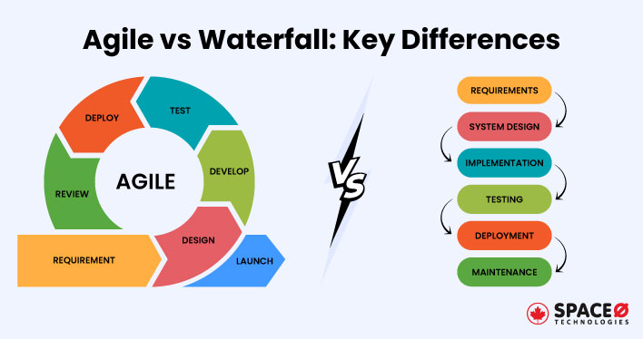
Agile vs Traditional Models
Waterfall Model: Linear and sequential development.
  Limited flexibility for changes.
Agile Model: Incremental and iterative approach.
  Allows continuous improvement and adaptation.

Slide 16
Scrum Framework Overview
Scrum is a popular Agile methodology with defined roles, events, and artifacts to guide teams.
Roles:
  Product Owner: Represents stakeholders, prioritises the backlog.
  Scrum Master: Ensures adherence to Scrum practices, removes impediments.
  Development Team: Delivers incremental value.
Events:
  Sprint Planning, Daily Standups, Sprint Review, and Sprint Retrospective.

Slide 17
Scrum Artifacts
Product Backlog:
  A prioritised list of tasks or features for the product.
Sprint Backlog:
  Selected tasks for the current sprint.
Increment:
  The sum of all completed product backlog items during a sprint.

Slide 18
Sprint Workflow
Sprint Planning: Define sprint goals and select backlog items.
Daily Standups: Short meetings to align team progress.
Sprint Execution: Development of chosen tasks.
Sprint Review: Demonstrate completed work to stakeholders.
Sprint Retrospective: Reflect and improve.
Example: Daily standups ensure quick identification and resolution of blockers.

Slide 19
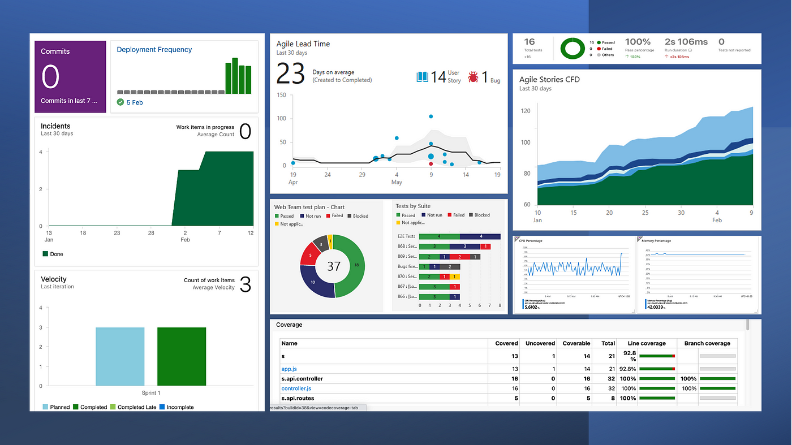
Agile Metrics
Velocity: Measures team productivity by completed story points.
Burn-down Chart: Tracks work completed vs remaining during a sprint.
Cycle Time: Measures how long a task takes from start to finish.
Practical Use: Use velocity trends to plan future sprints more accurately.

Slide 20
Azure DevOps - Introduction
Azure DevOps is a cloud-based platform for managing software development projects.
Key features:
  Boards: Track work with Kanban boards and backlogs.
  Repos: Manage Git repositories.
  Pipelines: Automate builds and deployments.

Slide 21
Azure Boards for Agile Teams
Kanban Boards:
  Visualise tasks and workflows.
  Customisable columns and work item types.
Backlog Management:
  Prioritise tasks and features.
  Break down work into user stories.
Example: A team tracks a sprint backlog with Azure Boards to monitor task completion.

Slide 22
Using Azure Repos
Host and manage your Git repositories.
Features:
  Code collaboration with pull requests.
  Code reviews to maintain quality.
  Branch policies to enforce standards.
Notes:
Practical Tip: Use branching strategies like Git Flow to manage feature development and releases.

Slide 23
Continuous Integration with Azure Pipelines
Set Up Pipelines:
  Automate building and testing code.
Key Concepts:
  Build Triggers: Automatically build code upon changes.
  YAML Configuration: Define pipeline steps programmatically.
Benefits:
  Early detection of defects.
  Consistent quality.

Slide 24
Practical Example - Scrum in Azure
DevOps
Scenario:
  Product Owner creates backlog items in Azure Boards.
  Scrum Master facilitates sprint planning with the team.
  Development Team tracks progress using Kanban boards.
Tools Used:
  Azure Boards for tracking.
  Azure Repos for code management.

Slide 25
Challenges in Agile Implementation
Resistance to change from traditional methods.
Difficulty in maintaining continuous collaboration.
Adapting Agile practices to distributed teams.
Tips:
Conduct Agile training sessions.
Use tools like Azure DevOps to improve transparency and communication.

Slide 26
Real-World Case Study
Case Study: Spotify’s Agile Transformation
  Adopted Agile to foster innovation and rapid delivery.
  Introduced Squad and Tribe models for team autonomy.
  Results: Faster releases, improved collaboration, and customer satisfaction.

Slide 27
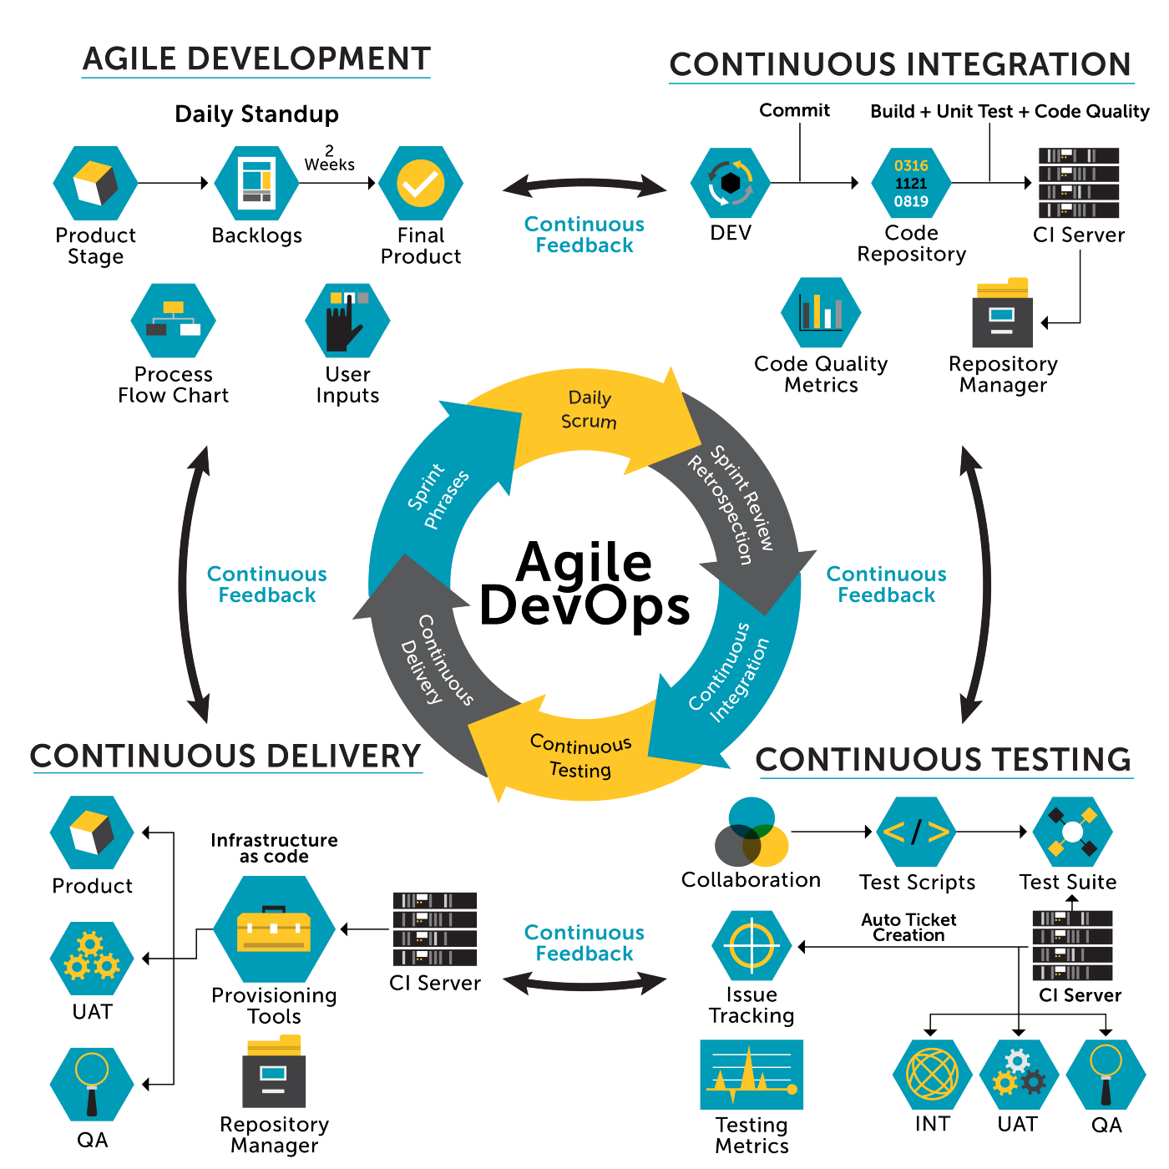
Agile and DevOps Synergy
Agile focuses on iterative development and collaboration.
DevOps emphasises automation, integration, and delivery.
Together, they enable faster, more reliable software delivery.

Slide 28
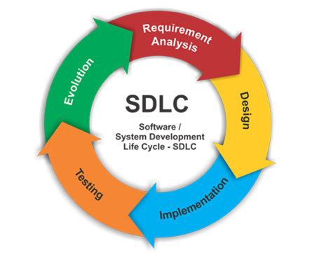
What is the SDLC?
Definition:
  A structured process for developing software.
  Ensures high-quality software through systematic planning, building, and testing.
Why It Matters?
  Reduces project risks.
  Improves software quality.
  Streamlines communication among teams.

Slide 29
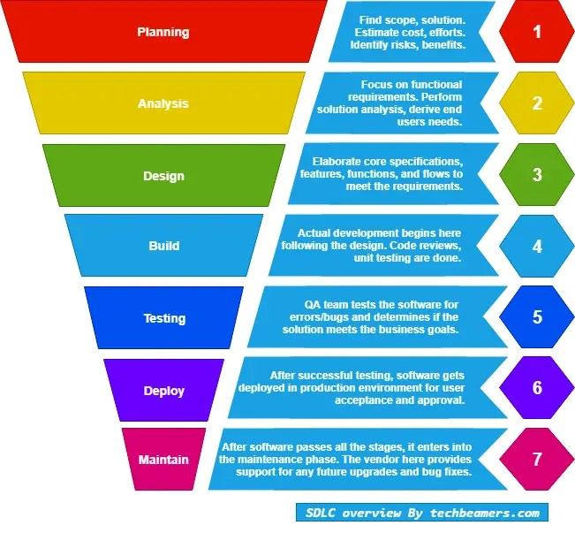
Phases of the SDLC
Requirements Analysis.
Design and Architecture.
Implementation.
Testing.
Deployment and Maintenance.

Slide 30
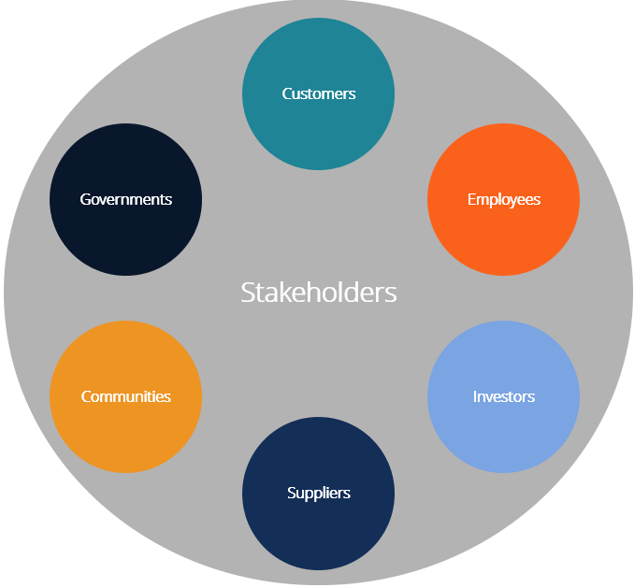
Requirements Analysis: Stakeholder Identification
Who Are Stakeholders?
  Individuals or groups impacted by the project.
  Examples: End-users, project sponsors, regulators.
Methods:
  Interviews.
  Surveys.
  Stakeholder mapping.

Slide 31
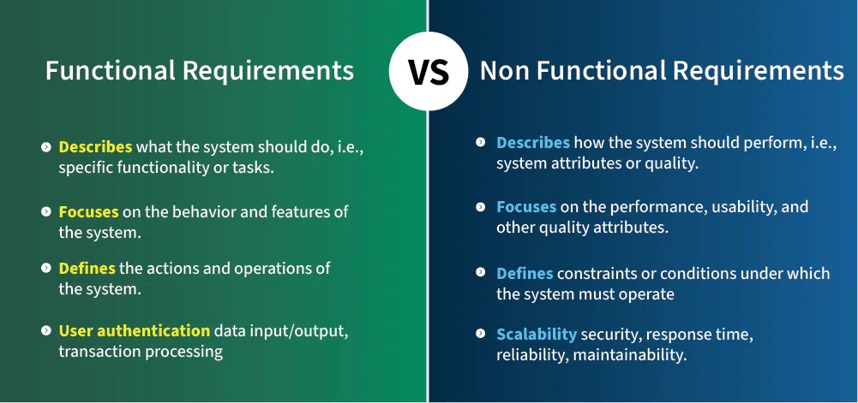
Requirements Gathering Techniques
Approaches:
  Use cases and user stories.
  Workshops and brainstorming sessions.
  Observation and prototyping.
Output:
  Functional requirements: "What should the system do?“
  Non-functional requirements: "How should the system perform?"

Slide 32
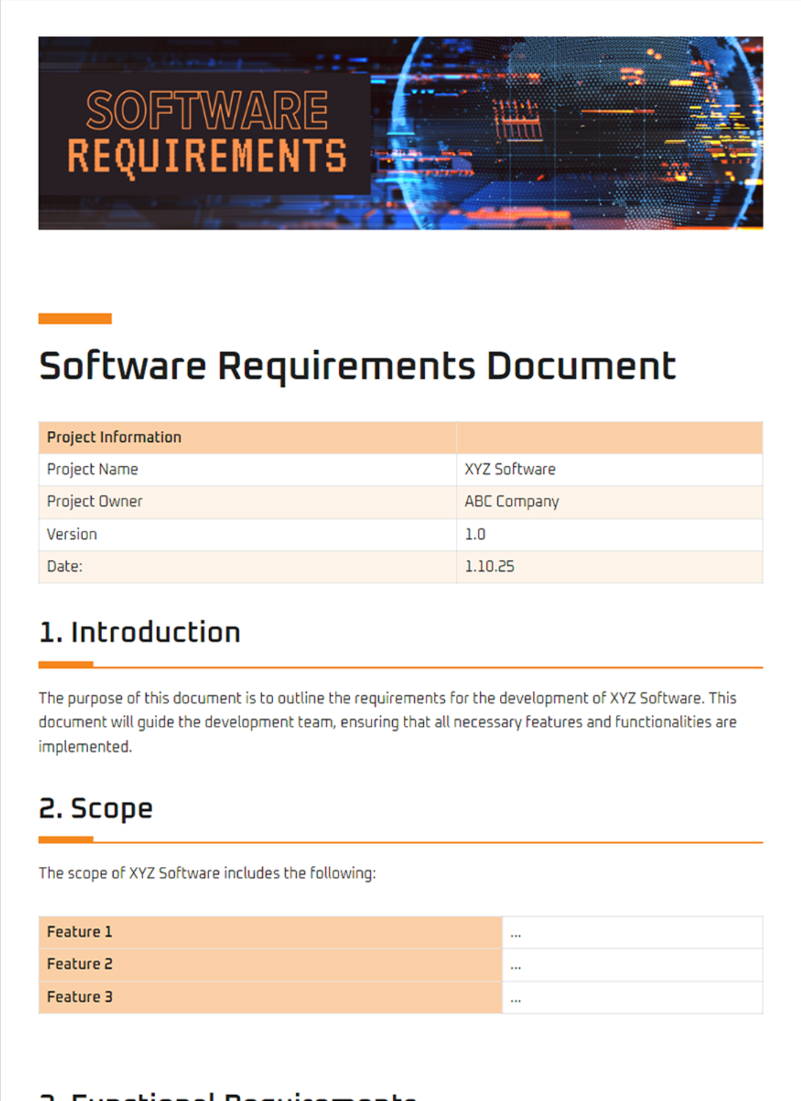
Requirements Documentation
Key Documents:
  Functional Requirement Specification (FRS).
  Non-Functional Requirement Specification
  (NFR).
  User stories or use case diagrams.
Benefits:
  Clear communication of requirements.
  Easier validation and verification.
See the example here.

Slide 33
Design and Architecture
System Design Principles:
  Modularity: Divide systems into manageable components.
  Scalability: Plan for growth.
  Maintainability: Ensure easy updates and bug fixes.
Output:
  System architecture diagrams.
  Component specifications.
  Interface definitions.

Slide 34
Component Design
What Is Component Design?
  Breaking the system into independent modules.
  Defining roles and interactions between modules.
Example:
  Payment module.
  Authentication module.
  User management module.

Slide 35
Implementation
Best Practices:
  Follow coding standards for readability and maintainability.
  Use version control systems like Git.
  Conduct regular code reviews.
Coding Standards:
  Example: Consistent indentation, meaningful variable names.

Slide 36
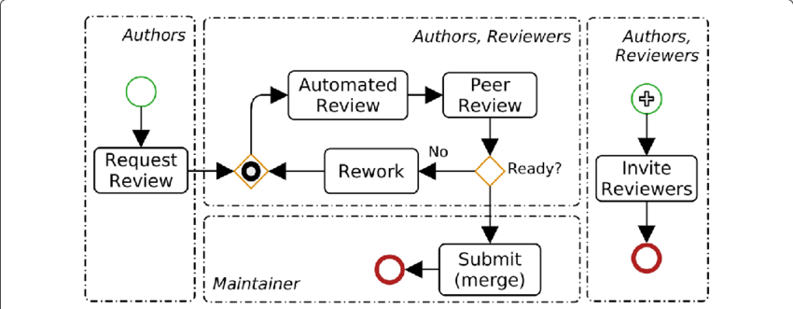
Code Reviews
Why Code Reviews?
  Catch bugs early.
  Share knowledge among team members.
  Improve overall code quality.
Process:
  Create a pull request.
  Assign reviewers.
  Address feedback and merge changes.
Image source and paper is from here

Slide 37
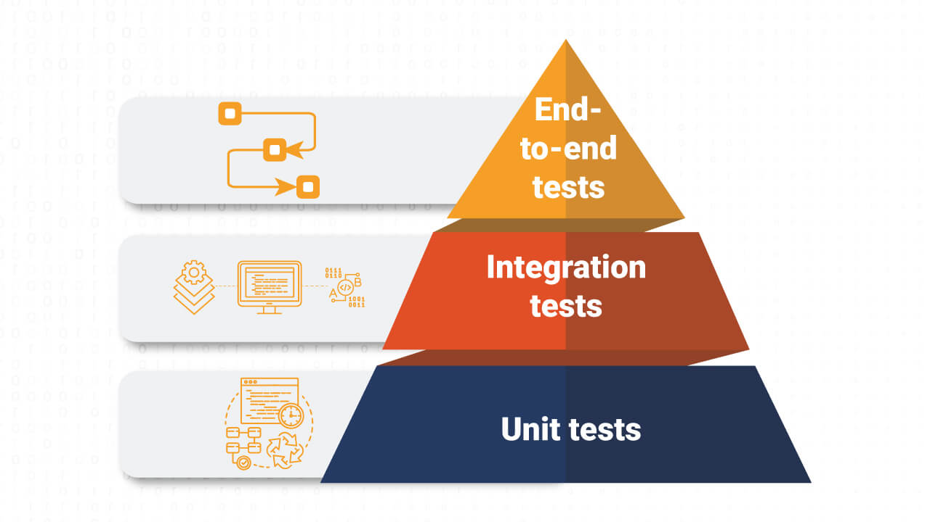
Testing Strategies
Types of Testing:
  Unit Testing: Test individual components.
  Integration Testing: Test interactions between components.
  System Testing: Verify the entire system works as expected.
Why Testing?
  Prevents bugs from reaching production.
  Improves reliability and performance.

Slide 38
Practical Examples for Git and Azure Repos

Slide 39
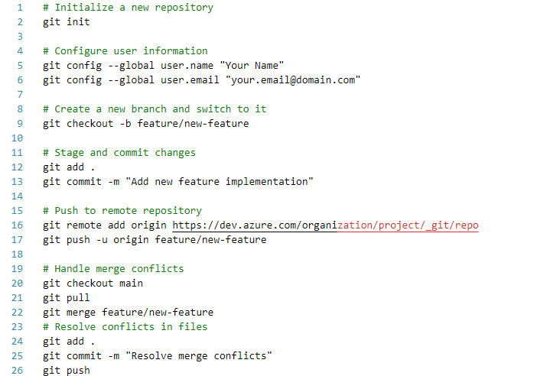
Example 1: Git Operations

Slide 40
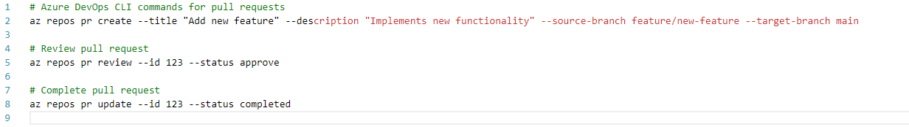
Example 2: Azure Repos Pull Request Workflow

Slide 41
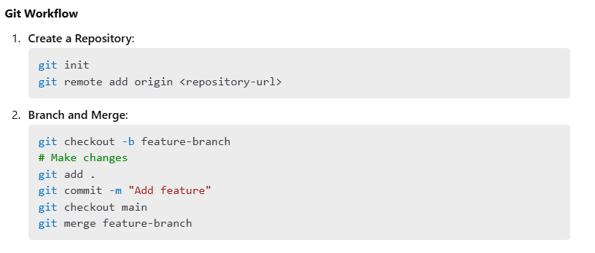
Example 3: Git Workflow

Slide 42
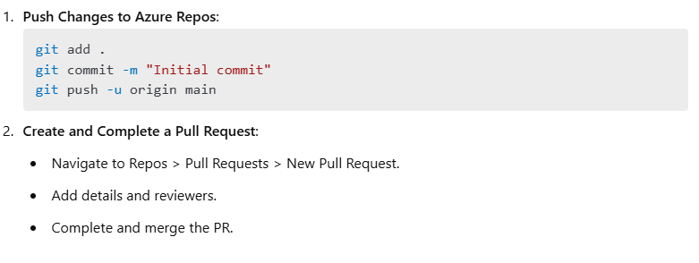
Example 4: Azure DevOps Workflow

Slide 43
Practice Exercises
Git Operations
  Create a repository with multiple branches
  Practice merge conflict resolution
  Implement feature branch workflow
Azure Repos Integration
  Set up a project in Azure DevOps
  Create and manage pull requests
  Implement branch policies

Slide 44
Summary and Q&A
Git Basics: Repository management, staging, committing, branching, and merging.
Azure Repos Integration: Repository setup, pull requests, and code reviews.
Practical Demonstrations: Git workflow and Azure DevOps features.

Slide 45
Discussion Questions:
What are the benefits of branching in Git?
How do pull requests enhance collaboration in a team?

Slide 46
Further Reading
Books:
  "Pro Git" by Scott Chacon and Ben Straub (Available online for free)
  "Git for Teams" by Emma Jane Hogbin Westby
Online Resources:
  Git Documentation
  Microsoft Learn: Azure Repos
  Atlassian Git Tutorials
Tutorials:
  Learn Git Branching (Interactive)
  Git and GitHub Crash Course
Community Forums:
  GitHub Community Discussions
  Reddit: r/git
Tools and References:
  GitKraken, Sourcetree (GUI tools for Git)
  Azure DevOps CLI

Slide 47
Further Reading
Books:
  Scrum: The Art of Doing Twice the Work in Half the Time by Jeff Sutherland.
  Agile Estimating and Planning by Mike Cohn.
Online Resources:
  Agile Manifesto.
  Microsoft Learn: Azure DevOps.
Tools:
  Azure DevOps Demo Generator.
  Jira for Agile Project Management.

Slide 48
Further Reading
Books:
  Software Engineering: A Practitioner’s Approach by Roger Pressman.
  Design Patterns: Elements of Reusable Object-Oriented Software by Erich Gamma et al.
Online Resources:
  GeeksforGeeks: Software Development Life Cycle.
  IBM: Introduction to SDLC.
Tools:
  Lucidchart: For architecture diagrams.
  Azure DevOps: For managing the SDLC process.

Slide 49
Next Week
Week 3: Data Structures - Arrays and Lists

